Slide 1
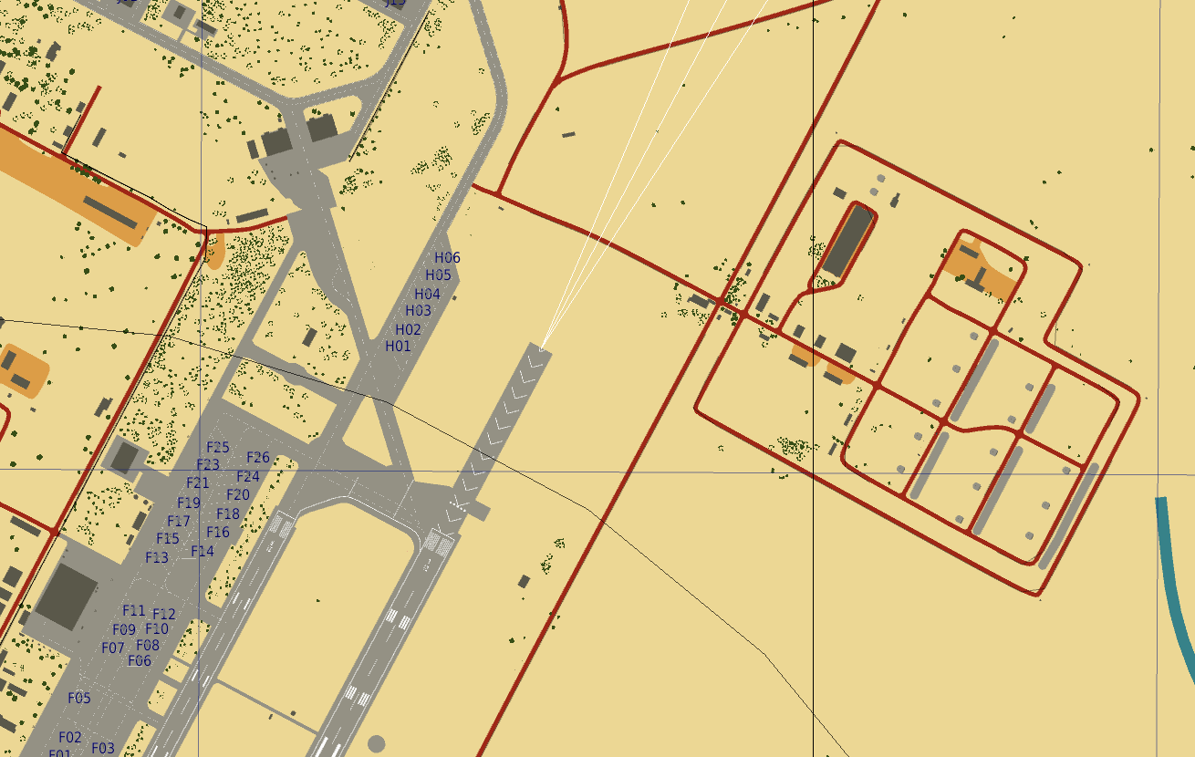
RETASKING ORDER 18-002
To: BLADE flight
Reference:
VIS Intel Report 18-001
Retasking order 18-001
SITUATION:
A FARP is beeing constructed closer to the target area as described in VIS Intel Report 18-001 and Retasking order 18-001. Fuel and ammo need to be delivered for the FARP to be operational.
MISSION #1:
BLADE flight is to pick up fuel (Barrels) and ammunition (ammo) from the storage shown on picture below.
Transport these items to the FARP under construction.
Contact JTAC SPARTAN when delivery is complete.
MISSION #2:
Standby in the area, under JTAC SPARTAN control for potential MEDEVAC/CASEVAC mission
FARP location:
N27 26.300 E056 59.200, elevation 699ft
JTAC SPARTAN FREQUENCY:
Primary: 136.750 (OCHRE 8)
Secondary: 38.50 (OCHRE 7)
Storage area

